Slide 1
INTERNATIONAL
DEVELOPMENT
PLAYER MOVEMENT CARDS

Slide 2
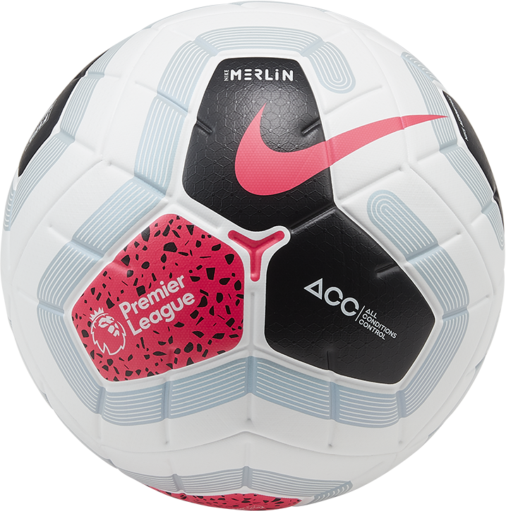
1
INTERNATIONAL
DEVELOPMENT
BALANCE KICK UPS
HOW TO PLAY…
Everyone must have a ball each, one foot must be locked and stuck still into the surface
The rest of your body aims to do as many kick ups as possible
CHALLENGE YOURSELF MORE…
Only the standing foot can touch the ground
When kicking the ball, the ball cannot go above knee height
FOCUS: BALANCE

Slide 3
2
INTERNATIONAL
DEVELOPMENT
HIGH DIVE
HOW TO PLAY…
Find a team mate and work in pairs facing each other
One player is the leader and has a bib or a ball in each hand, they have their arms at full length out beside them
The other player must anticipate the item dropping, whenever one is dropped the other player must dive to catch it before it touches the ground
CHALLENGE YOURSELF MORE…
With the ball it can be controlled with the feet instead of caught
This game can be played without bibs, instead the game is played with a closed fist or an open high 5, the player is only allowed to tag high 5’s
FOCUS: CO-ORDINATION

Slide 4
3
INTERNATIONAL
DEVELOPMENT
cone catcher
HOW TO PLAY…
Players work in pairs or small groups
The aim is for one player to half volley the ball or volley the ball from their hands towards their partner who catches it inside their cone
CHALLENGE YOURSELF MORE…
Points system
Distance challenges
Kicking challenges
Only catch in one hand
Catcher must move or stand a particular way
FOCUS: CO-ORDINATION

Slide 5
4
INTERNATIONAL
DEVELOPMENT
hand tennis
HOW TO PLAY…
Players work in pairs, facing each other, they are to hold hands with one hand and with a straight arm, this is now the net for tennis
The other hand is the racket or the feet can be used to pass the ball based on their ability
The aim is to transfer the ball across the net and compete against one another or work as a team
CHALLENGE YOURSELF MORE…
In-between every shot they players must execute a squat
The game can be played as a team to score as many points/transfers as possible
FOCUS: CO-ORDINATION

Slide 6
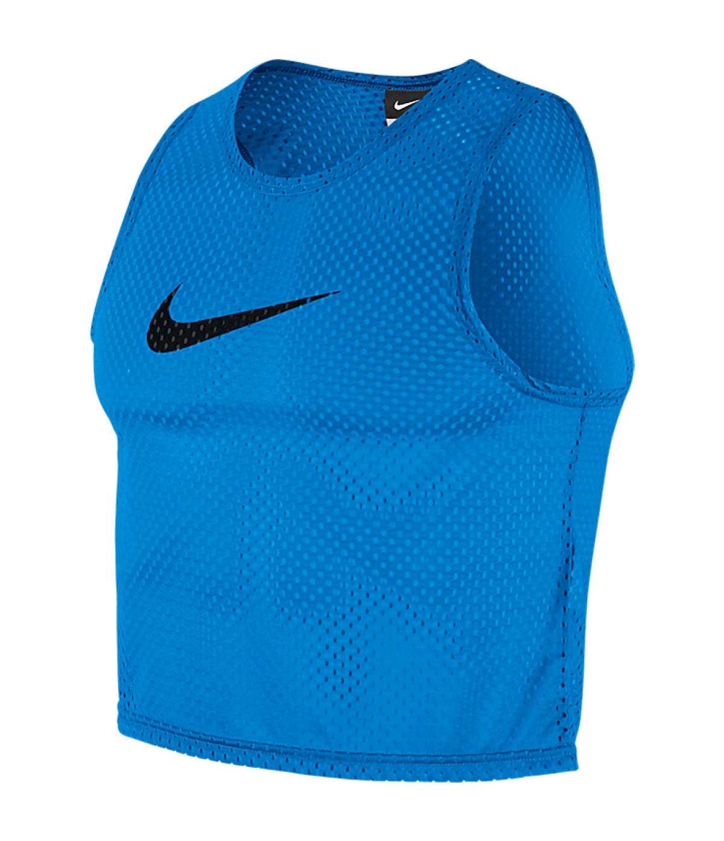
5
INTERNATIONAL
DEVELOPMENT
scarecrow speed
HOW TO PLAY…
Players work in groups of three
One player is placed at a specific distance set by the coach with their arms out (like a scarecrow), with a bib in each hand
On the scarecrows call, the two sprinters go and the aim is to get their bib first
The scarecrow judges who claims victory based upon which bib was taken out their hand first
CHALLENGE YOURSELF MORE…
Balls in the scarecrows eye line instead of bibs and the first person to score wins
Change the start position of players, they could be sat down, laying down or on their front
FOCUS: SPEED

Slide 7
6
INTERNATIONAL
DEVELOPMENT
sPEED SCORE
HOW TO PLAY…
Players work in groups of 2
On the players call, the two sprinters go and the aim is to get their ball first
The first player to score wins a point
CHALLENGE YOURSELF MORE…
Apply agility challenges in the middle instead of sprinting in lines
Change the start position of players, they could be sat down, laying down or on their front
FOCUS: SPEED

Slide 8
7
INTERNATIONAL
DEVELOPMENT
split speed
HOW TO PLAY…
Players work in groups of 3
2 players stand next to each other while the other server behind them with a ball and out of sight
The server feeds the ball over, under or around the pair and they must compete to print and get to the ball first and score, whilst the other player can tackle them
CHALLENGE YOURSELF MORE…
The football can be kicked through for the challengers
Change the start position of players, they could be sat down, laying down or on their front
FOCUS: SPEED

Slide 9
8
INTERNATIONAL
DEVELOPMENT
accel excel
HOW TO PLAY…
In pairs, one player aims to accelerate while having a bib across the front of their waist, the teammate has hold of this bib either side of the waist and aims to hold and resist the acceleration
The aim is to either resist as long as possible or let go at any time allowing the player to set off either to a target or to ball to score in a goal
CHALLENGE YOURSELF MORE…
Add more bibs for resistance
Adjust distances
FOCUS: ACCELERATION

Slide 10
9
INTERNATIONAL
DEVELOPMENT
push power
HOW TO PLAY…
Player 1 has their hands on player 2’s shoulders
Player 1 must aim to push player 2 while player 2 resists movement
Player 1 will be pushing through their legs as if they were accelerating
Winner is declared by how many times a player pushes their opponent over the line
CHALLENGE YOURSELF MORE…
Adjust distances
FOCUS: ACCELERATION

Slide 11
10
INTERNATIONAL
DEVELOPMENT
boxing tag
HOW TO PLAY…
This game can be played 1v1 or as a whole group
The simple objective is for everybody to tag each other on the knee, or the shoulder, or both
A point is scored if you get somebody, a point is lost if somebody gets you
CHALLENGE YOURSELF MORE…
Players play the same game by leap-frogging, bear crawling or as a crab
Include a ball each
Adjust areas size
FOCUS: AGILITY

Slide 12
11
INTERNATIONAL
DEVELOPMENT
push pARTS
HOW TO PLAY…
In pairs, players work facing each other and are held in a push up position
A ball or cone between the two players
The following instructions are suggested ideas:
Down = Execute a push Up, Up = Reset position, A body part = Touch or hold that body part, ball = grab ball
CHALLENGE YOURSELF MORE…
Point System
Instead of touching the body part, the body part has to move or leave the ground
FOCUS: CORE STRENGTH

Slide 13
12
INTERNATIONAL
DEVELOPMENT
WHEEL BARROW
HOW TO PLAY…
Player 1 is in a push up position with their legs being held besides the waist of player 2
Player 2 can let go of one leg at a time, player 1 must resist the drop and return the foot back into player 2’s hands
CHALLENGE YOURSELF MORE…
Player 1 performs push ups in-between foot drops
Player 2 performs squats in-between foot drops
Wheel barrow races
Introduce the ball
FOCUS: CORE STRENGTH

